Slide 1
Analysis between Business, Income, Education and Crime in St. Louis County

Slide 2
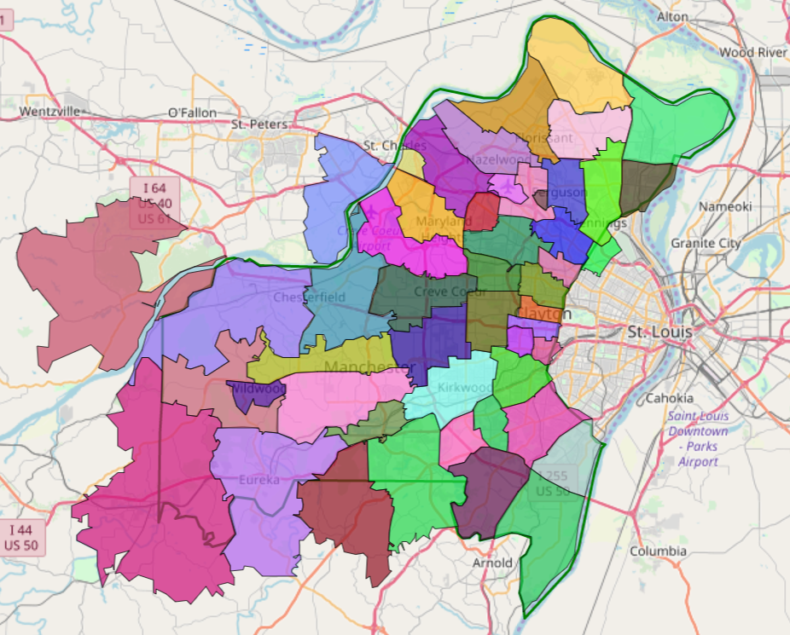
St. Louis County
Population: 998954
Zip codes: 52 (including P.O. Boxes)
Questions
What is the community income level, business activities, education, and crime rate?
What are their relationships?

Slide 3
Topics covered by this project:
A deep dive in communities defined by zip codes:
Business and income – Shujun
Zipatlas.com
Infohouse.com
Education level – Tanti
2018 Census
Crime rate – Carrie
2019 Crime from St. Louis County Government

Slide 4
Files Used:
crime = "Resources/UCR_Part_1_Crime_for_Multiple_St._Louis_County_Police_Departments%2C_2019_Year_to_Date.csv"
crime_df = pd.read_csv(crime)
pop = "Resources/St Louis County Zip Population.csv"
pop_df = pd.read_csv(pop)
popd_df = pop_df.loc[:, ['Zip Code', 'Population',]]
incomegroup_df = pd.read_excel (r'2018 St Louis County Income Cat by Zip clean.xlsx’)
businessbyzip_df = pd.read_csv('stlbusinesssum.csv')
businessbyzip_df.rename(columns={'Zip':'Zip Code'}, inplace=True)
file = "Resources/acs2018_5yr_B07009_86000US63040/acs2018_5yr_B07009_86000US63040/acs2018_5yr_B07009_86000US63040.csv"
mobility_stlc_df = pd.read_csv("Resources/acs2018_5yr_B07009_86000US63040/acs2018_5yr_B07009_86000US63040/acs2018_5yr_B07009_86000US63040.csv")

Slide 5
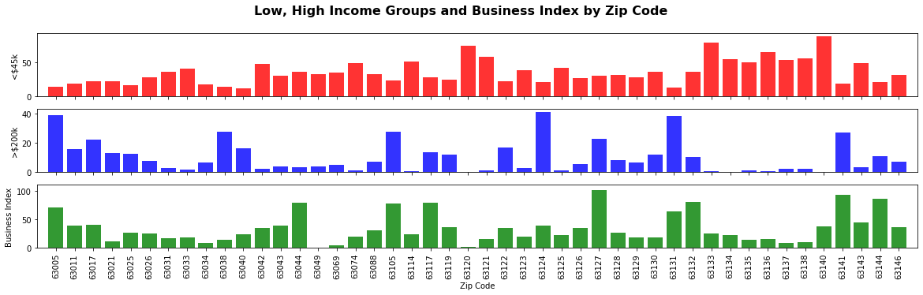
Bar Chart of Percentage of Household with Income Less Than $45k, Higher Than $200k, and Business Index

Slide 6
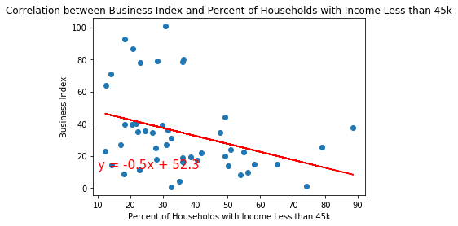
Negative trend is detected between business activity and percentages of household with income less than $45k or 25k
The r-squared is: 0.1183
The p-value is: 0.0192

Slide 7
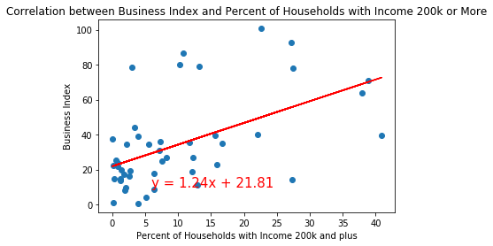

Positive trend is detected between business activity and percentages of household with income higher than $200k
The r-squared is: 0.2730
The p-value is: 0.0002

Slide 8
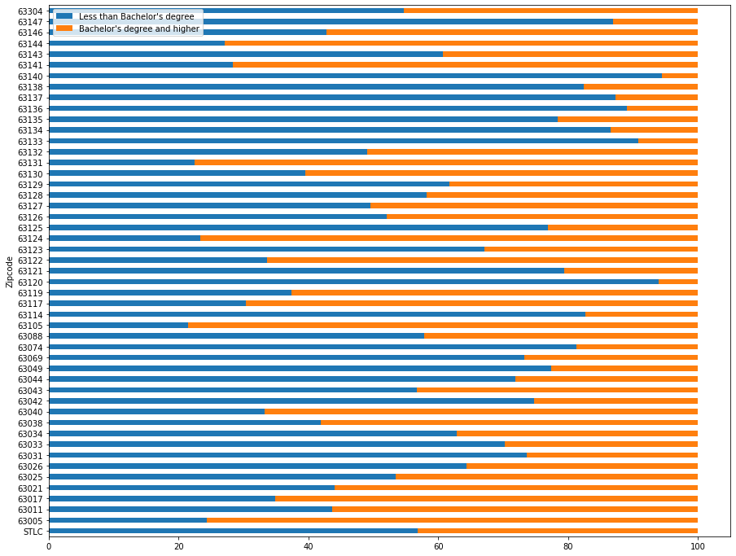
Comparative Study of St Louis Residents Level of Education by Zip Code
More people with less than a bachelor’s degree live in St Louis county
North county residents have the higher percent of residents with bachelor’s degree or higher:
Chesterfield, University City and Clayton, Ladue & Des Peres
Overall more people in north county and east do not have a bachelor’s degree or higher:
Kinloch, Berkeley
The household income has a good correlation with the education:
low level of education high percent of people with $25,000.00 or less

Slide 9
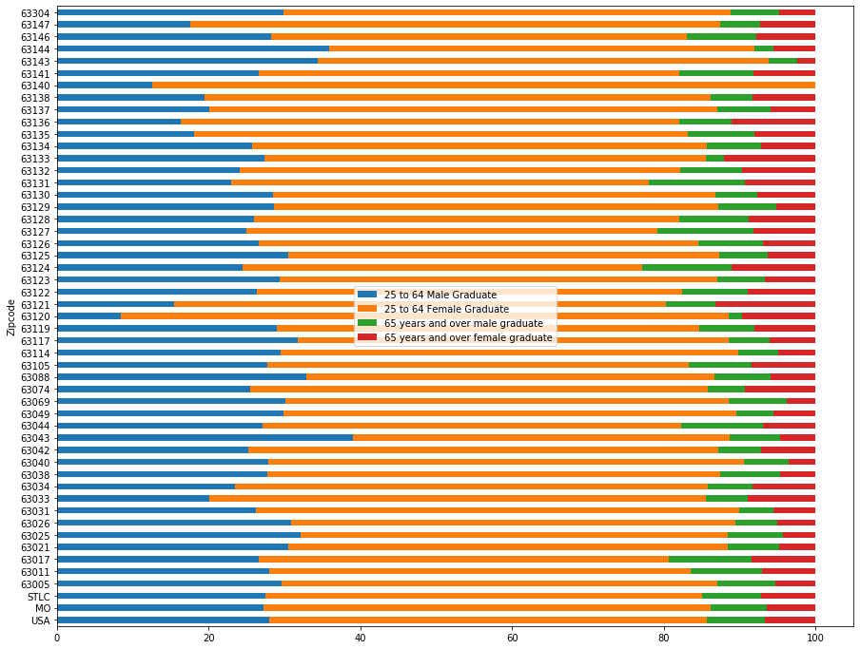
Comparative Study of St Louis Residents Level of Education by Gender and by Zip Code
The ratio of graduate female to graduate male in the age range of 25 to 64 years is more than 2x
The trend is observed in the US and in the state of Missouri:
The poorest zip code showed the higher ratio of female graduate to male graduate (9 to 1 in 63140 and 63120

Slide 10
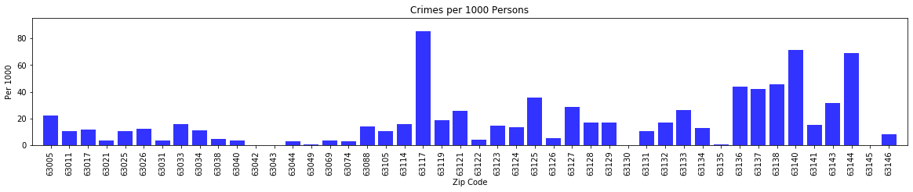
When we started looking at the crime in St. Louis County for 2019, we found there were over 16 thousand lines of crimes for the county. And that is amazingly intimidating. So we narrowed our scope, changing the crime to determine the crimes per 1000 people per zip code. This gave us a cleaner insight as to what cities were being hit the hardest. Richmond Heights hits the top of the scale with 85 crimes per 1000, but Kinloch and Brentwood are right behind with 71 and 68 crimes per 1000 people collectively.

Slide 11
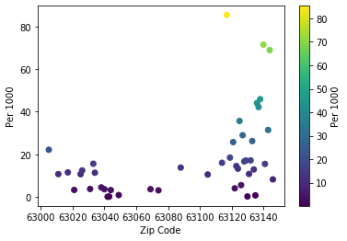
Looking at this scatterplot of crime within the county, you can see there are some outliers, areas of the county that are higher than most other zip codes. In referencing these zip codes, 63140, 63117 and 63144, you find that 2 of the cities, Richmond Heights and Brentwood, are business heavy areas, which explains the most common crimes, larceny, in those areas. The lone oddity is Kinloch. They have few business there, and only 291 residents.

Slide 12
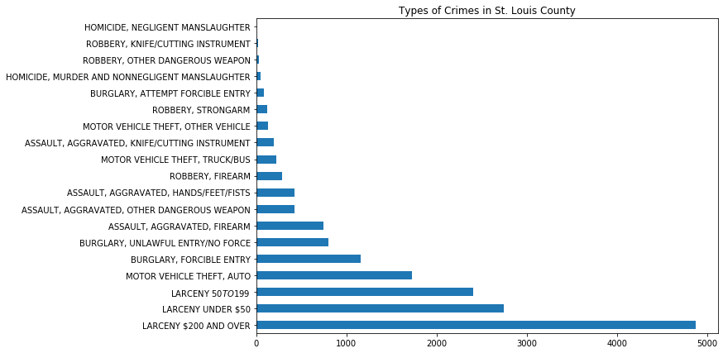
The types of crimes in St. Louis County

Slide 13

Analysis
While this is, by no means, a complete dataset, this is a good jumping off point to determine how best to make impactful decisions that can change the dynamic of a neighborhood. Despite weak, there is a negative correlation between business index and percentage of households with low income, and there is positive correlation between business index and percentage of households with high income. Kinloch is an excellent example of determining the lever to pull to turn the neighborhood around. The majority of residents live at or below the poverty line, the majority has less than a college degree and the crime is higher than the average zip code, even though there are only 291 residents. Opportunity would be key, perhaps a small business so residents wouldn’t have to rely on or find transportation; as well as as opportunity to increase education, could help residents pursue a better standard of living.
In comparing zip codes with a high crime rate against ones with a low crime rate, we found diversity in the education and income. Maryland Heights, Hazelwood and University City all had lower crime rates per 1000, but have a healthy mix of income, business and education.

